Slide 1
MindMend Phase 2
Yassin Elsharafi & Aaron Lin

Slide 2
Issue:
Affordable and accessible care for people with mental illnesses
This will include things such as medication, multiple different therapy types, peer support, and online immediate support to find what works best for them

Slide 3
Target Population:
Individuals experiencing mental health issues, especially those without health insurance or with low incomes

Slide 4
Design Research
Key Findings:
Unclear navigation on mental health platforms
Financial transparency regarding service costs
Limited affordable healthcare options
Inadequate availability of immediate support
The site will aim to address the difficulty of navigating separate platforms for finding sources of therapy and affordable medication and consolidate it into one easy to use and access location

Slide 5
Tasks:
Finding available providers and booking an appointment
Finding immediate help and connecting to a professional
Finding available sources of medication

Slide 6
Task 1: Using the Map to Find Available Providers and Booking
Why?
Many users struggle to locate nearby providers who offer affordable services.
Ensures that users can find resources based on their location, reducing barriers to care.
A map-based search allows for intuitive navigation and selection, helping users visualize their options.
Details:
Displays nearby providers, categorized by services (therapy, medication, insurance assistance).
Allows users to filter results by price, insurance compatibility, and type of care.
Provides detailed information about each provider, including contact information, specialties, and user reviews.
Enables direct booking with a provider, reducing the steps between search and action.

Slide 7
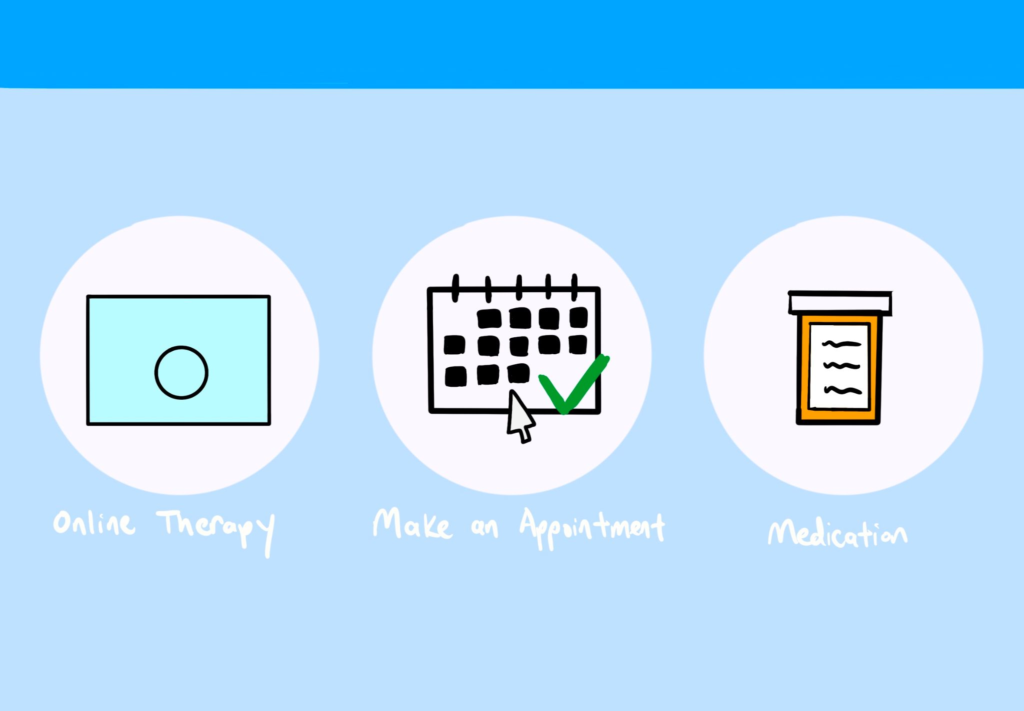
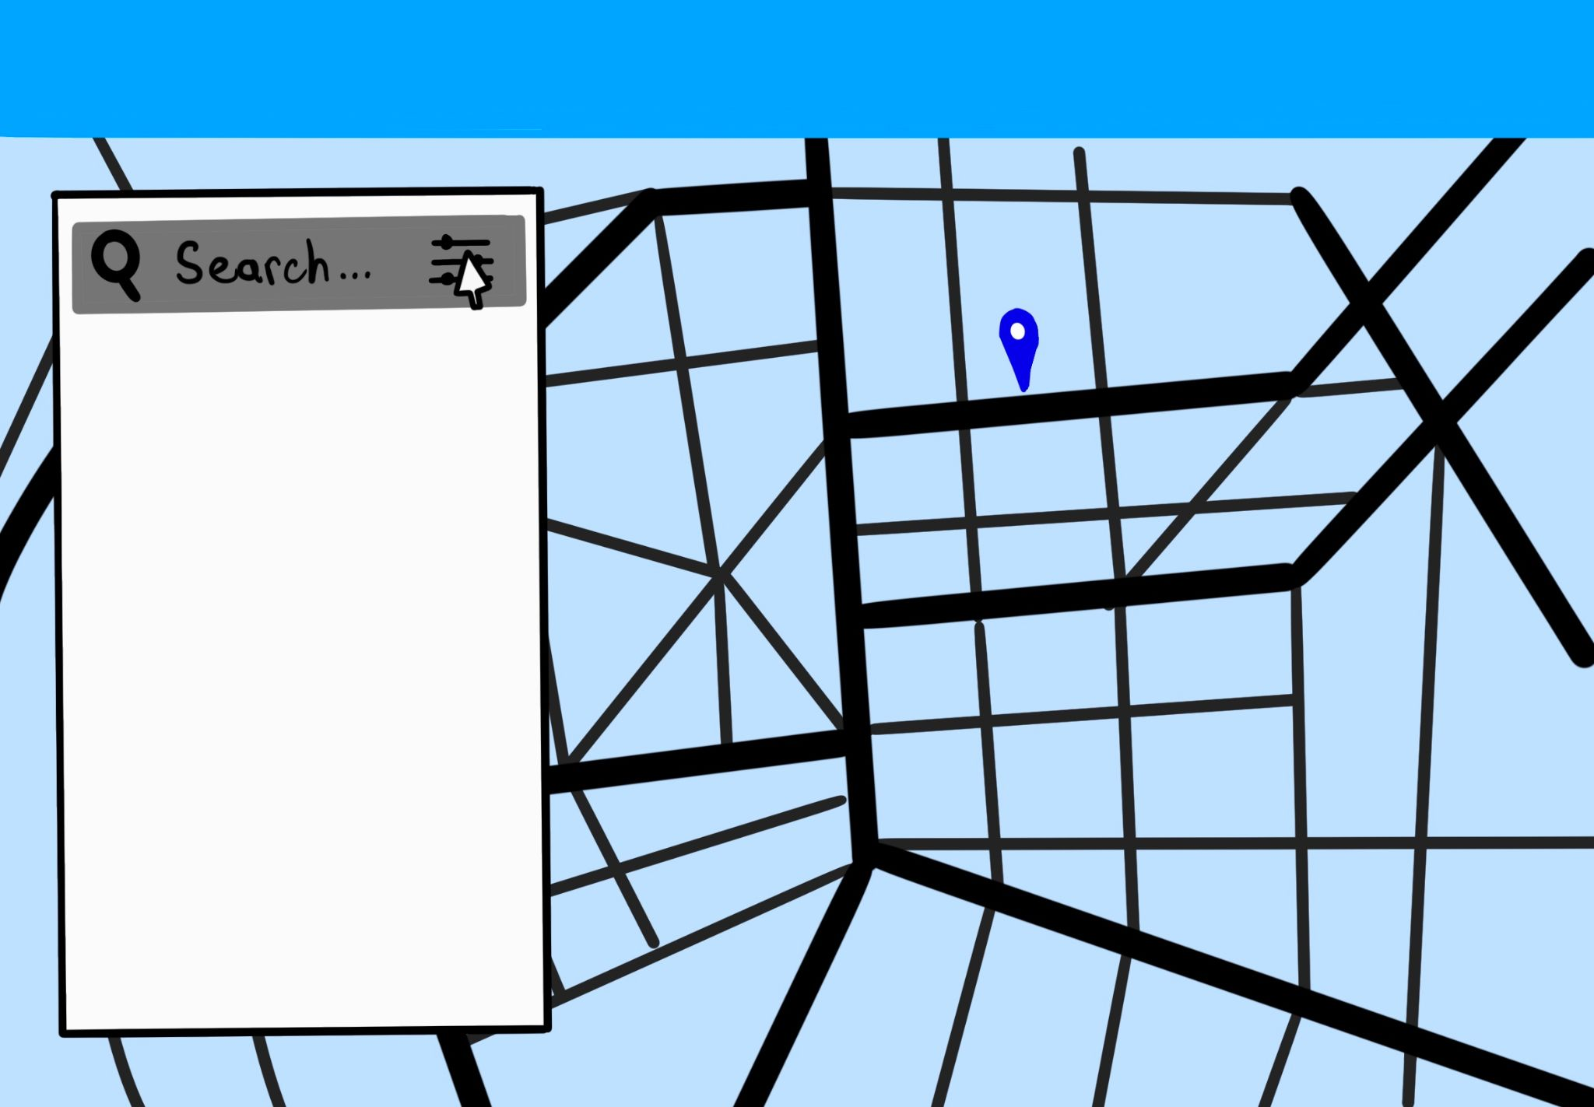
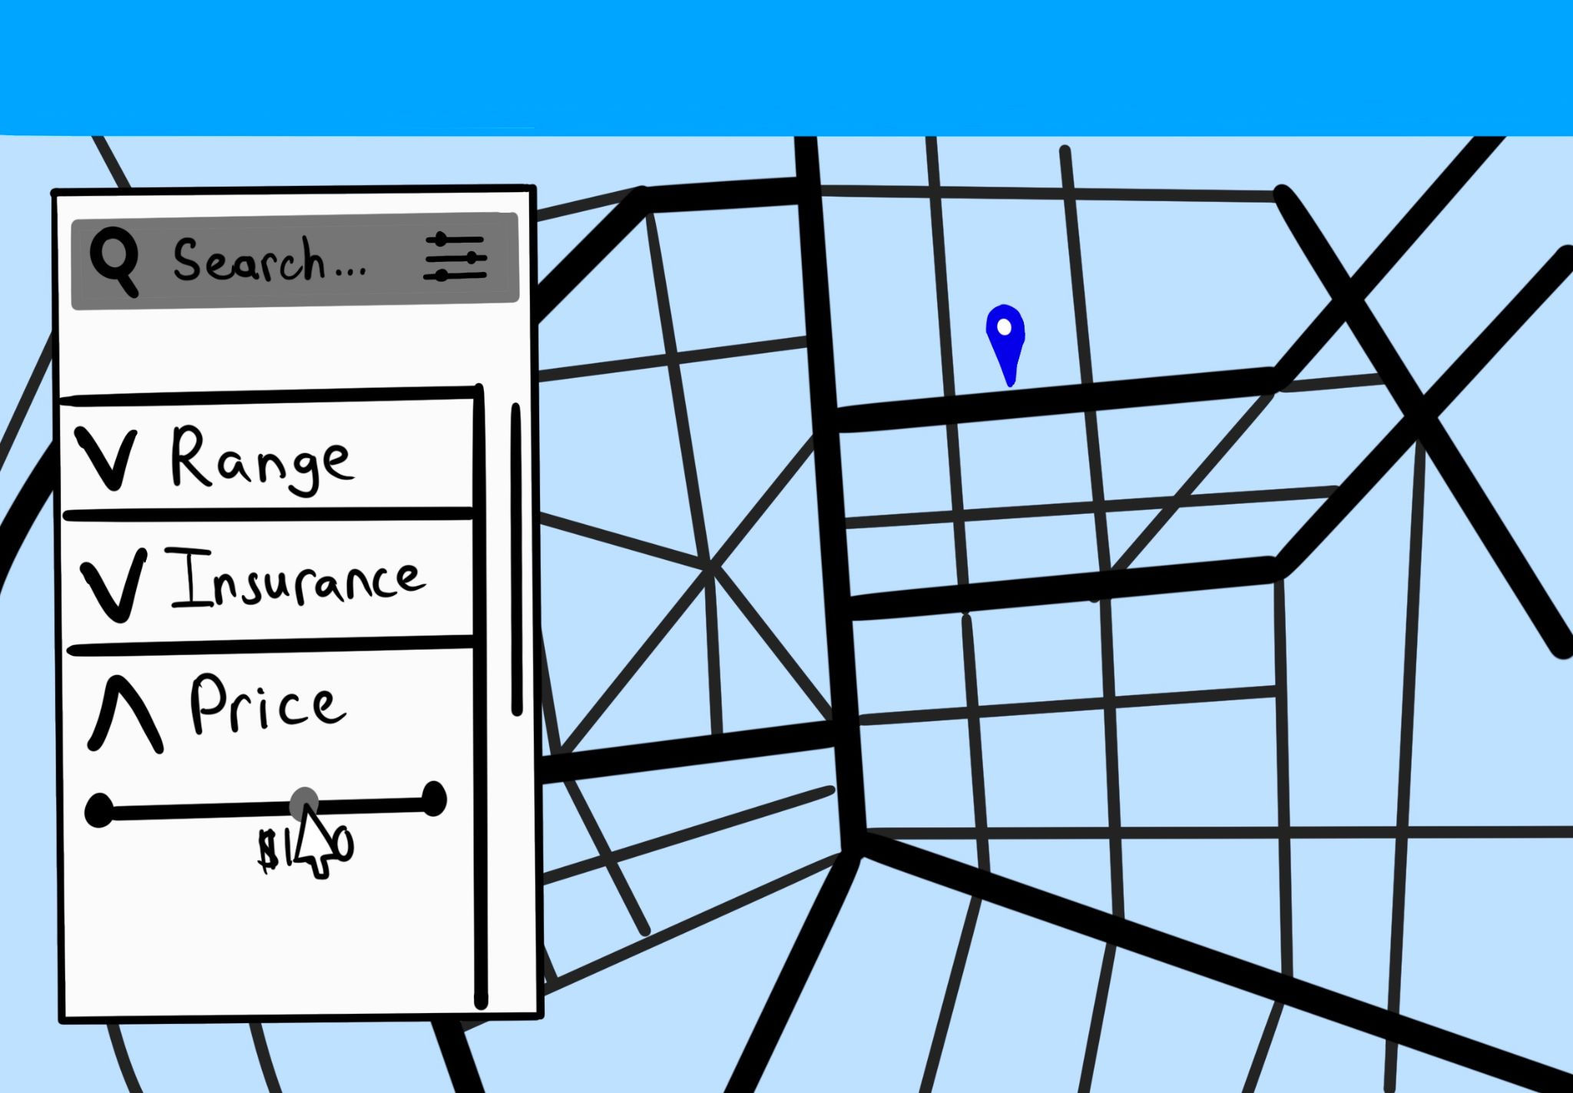
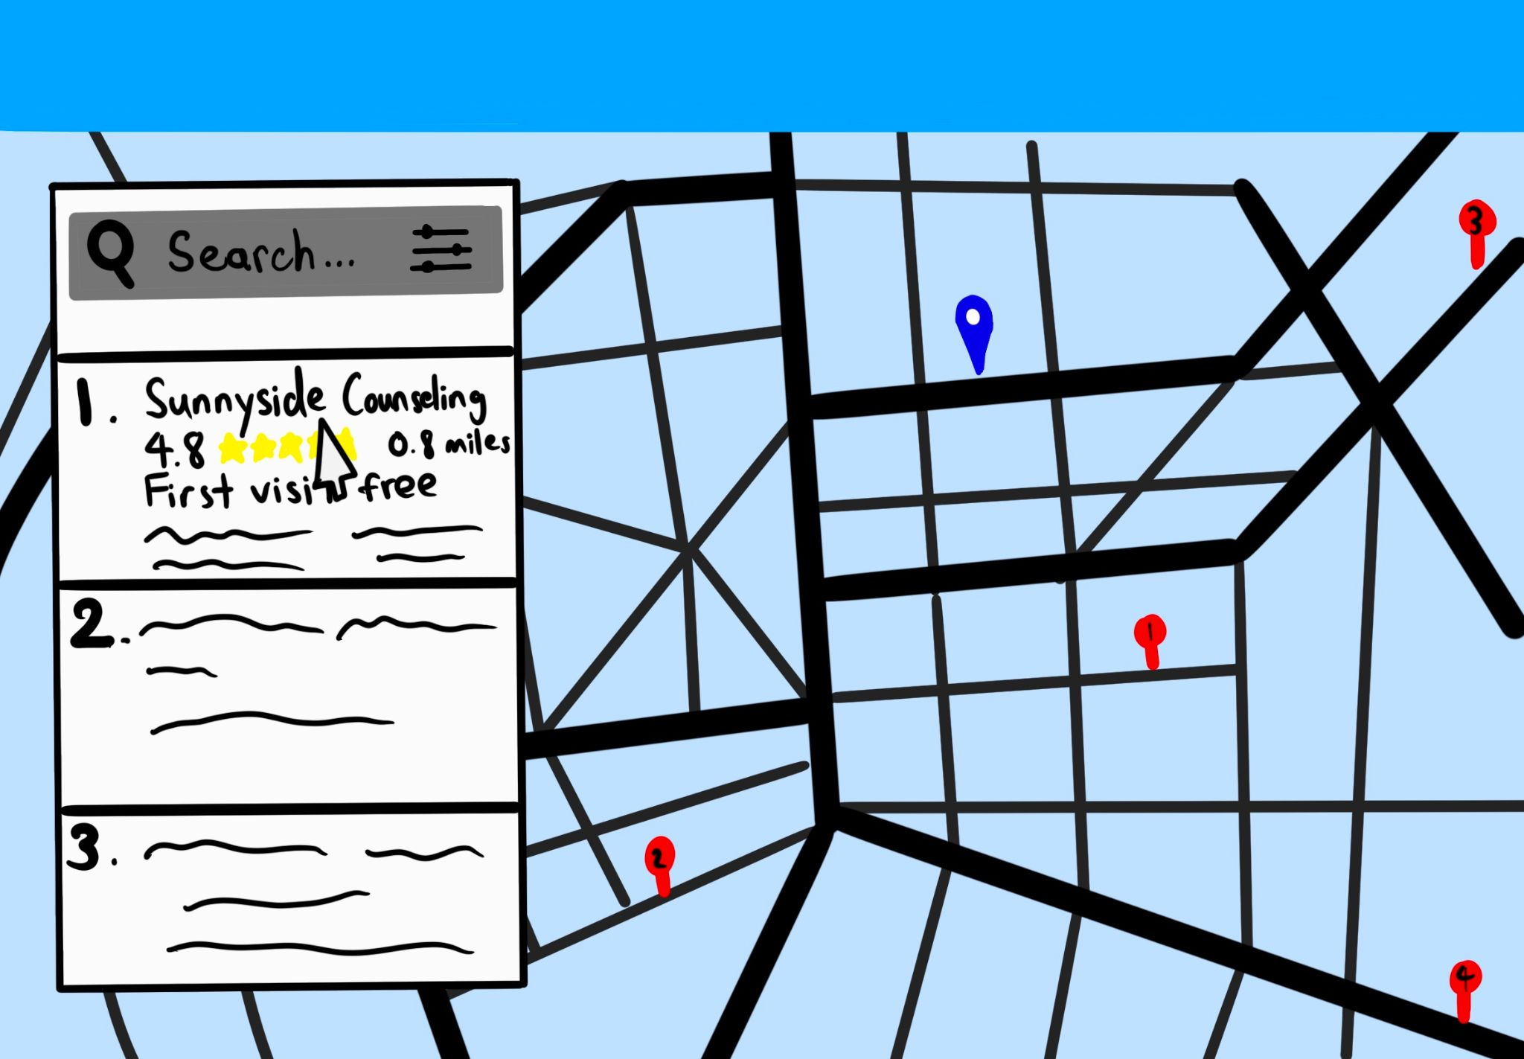
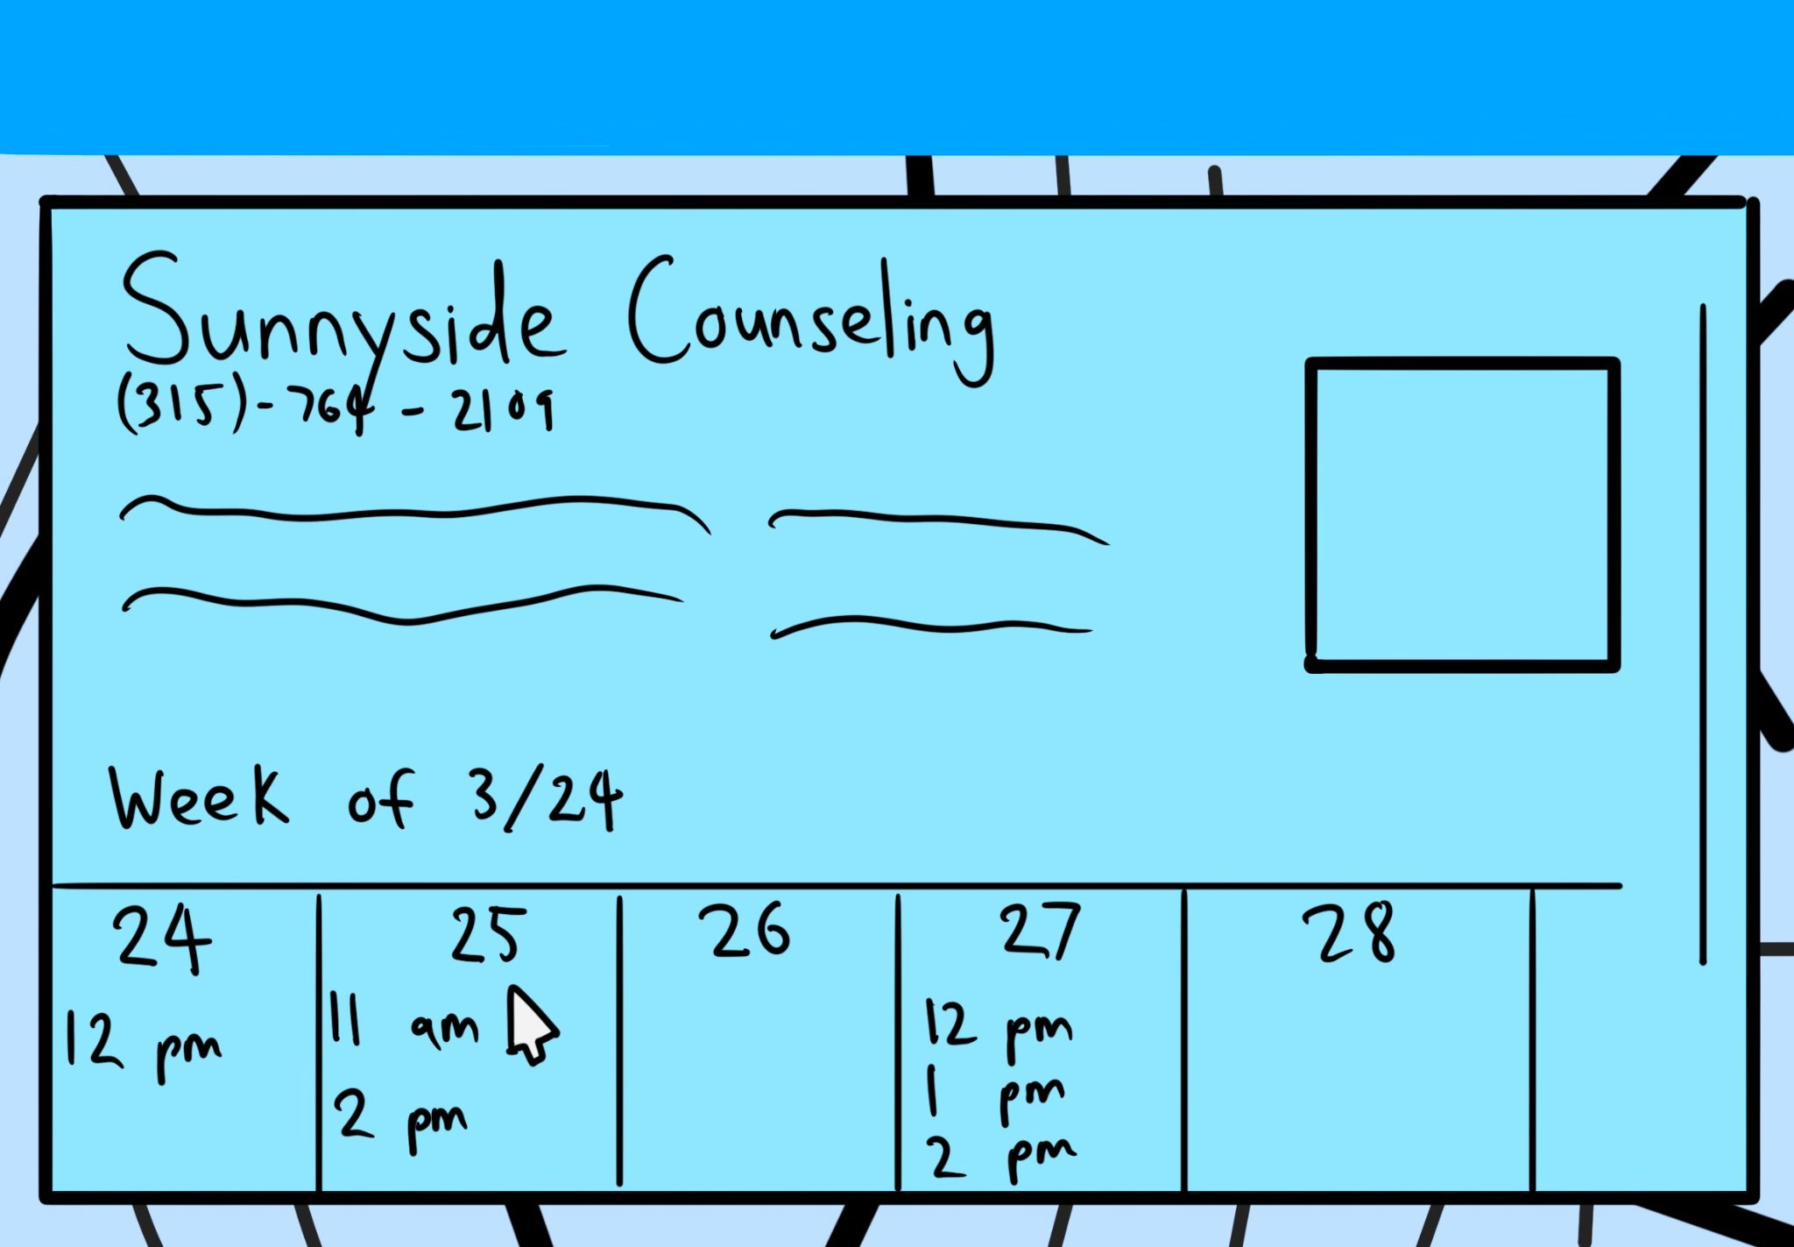
1. User chooses to make an appointment from home page
2. User selects drop down filter menu from search bar
3. User adjusts filter to their own parameters
4. User sees available options on map and selects desired option
5. User sees details and successfully makes appointment

Slide 8
Task 2: Using the Immediate Help Feature to Connect to a Professional
Why?
Many users need immediate support during mental health crises.
Provides a faster alternative for users unable to book a provider immediately.
Ensures that users can get timely help without navigating through multiple screens.
Details:
One-Tap Access: Users can connect with a mental health professional or crisis counselor through a dedicated button.
Chat or Call Option: Offers flexibility by providing either a live chat or a direct phone call.
Automated Triage: An initial assessment asks brief questions to route users to the appropriate type of support.

Slide 9
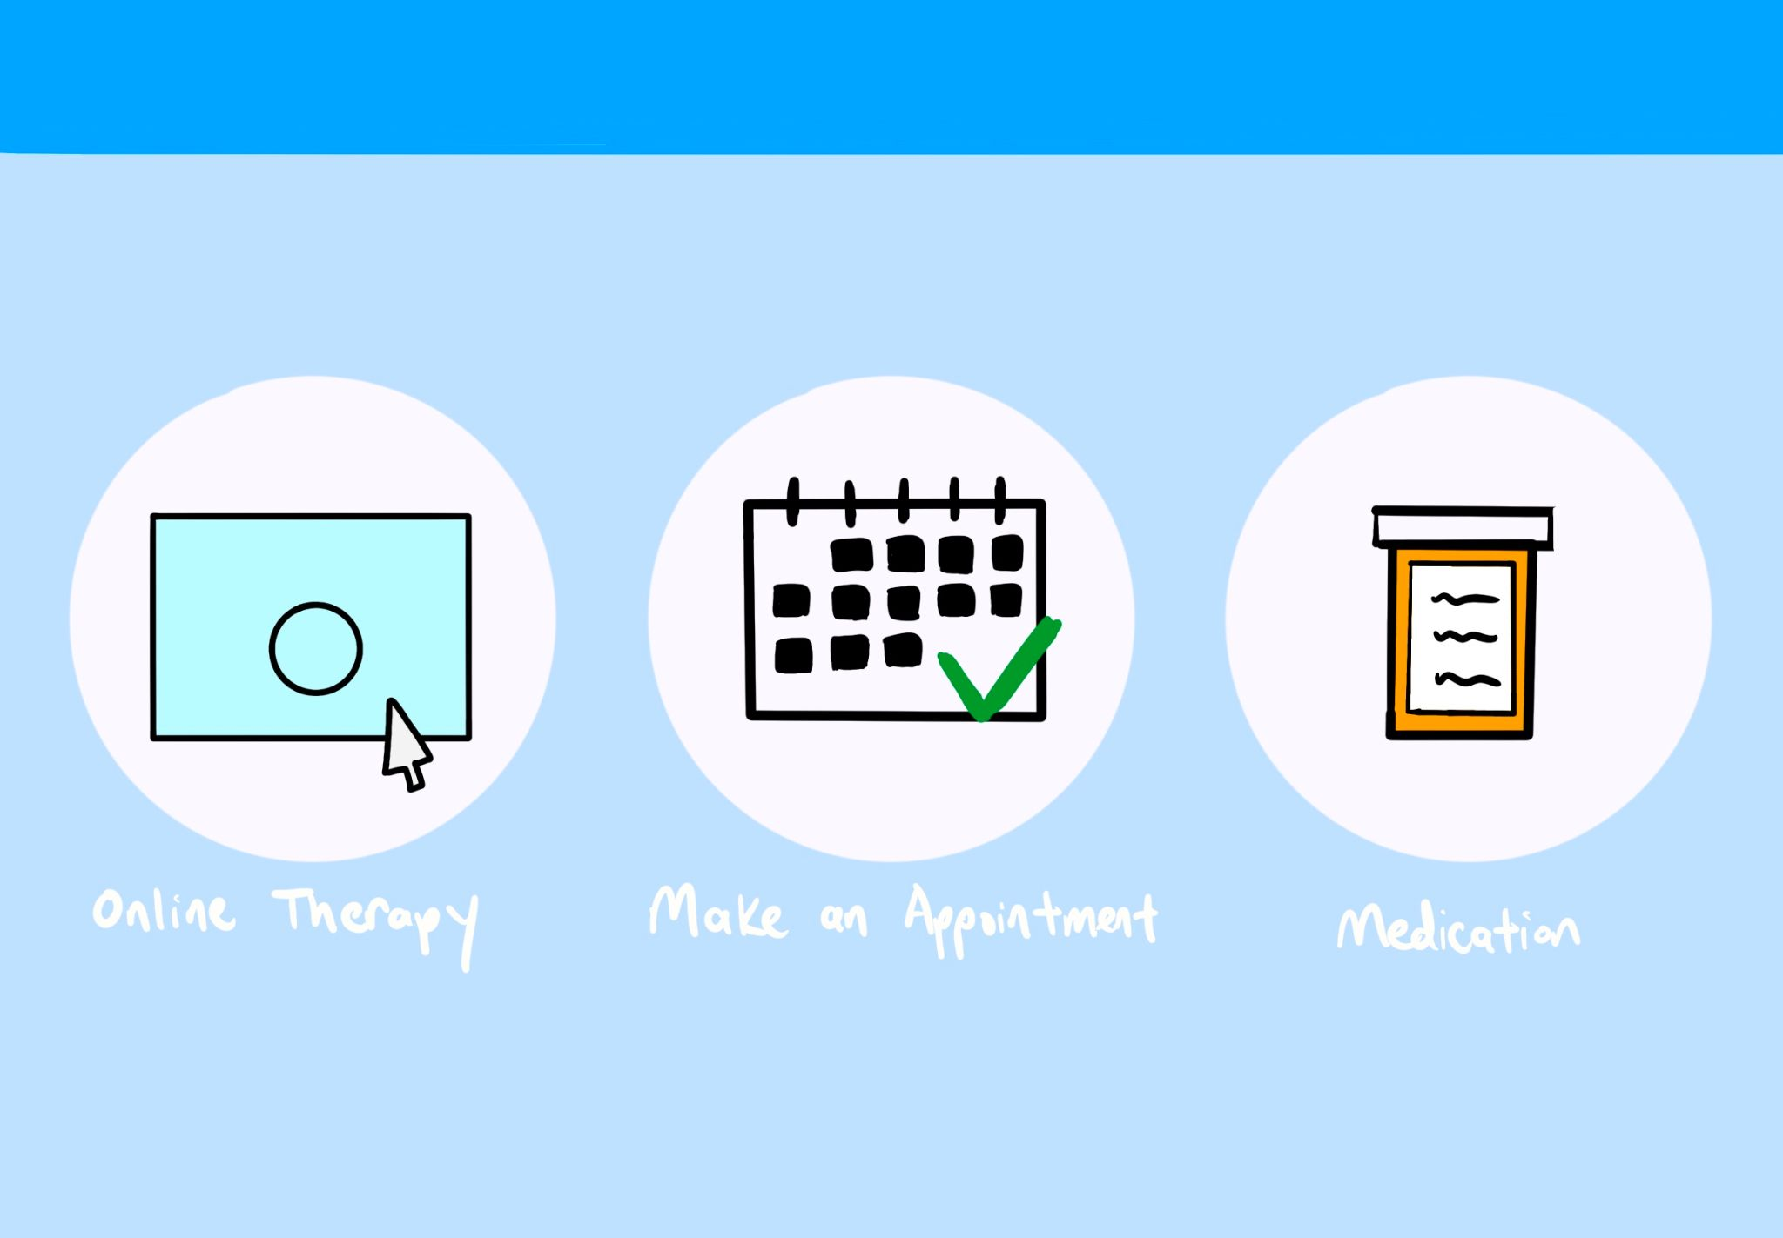
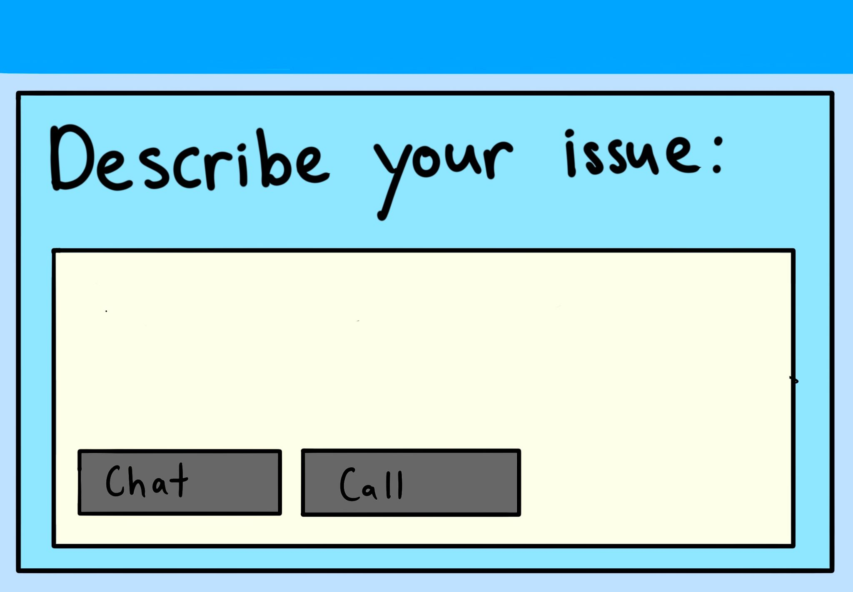
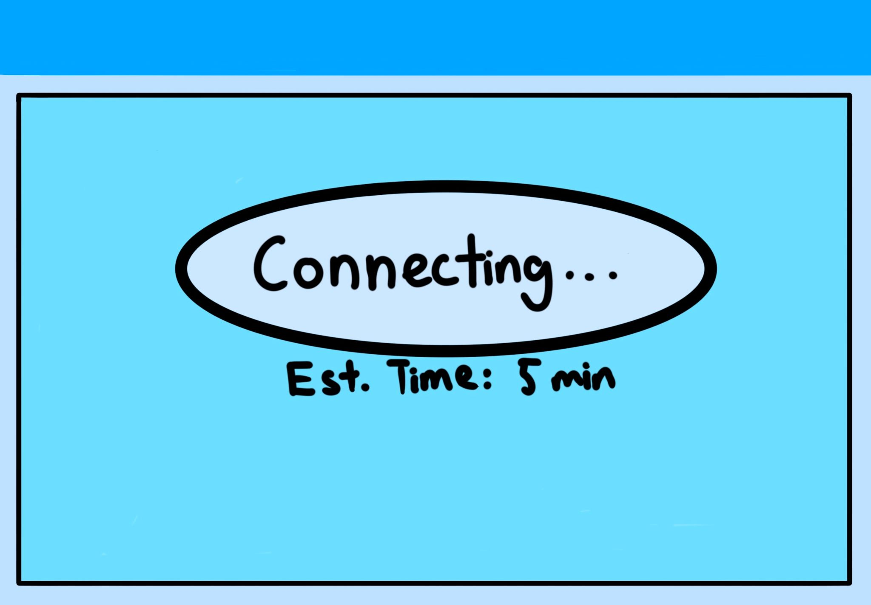
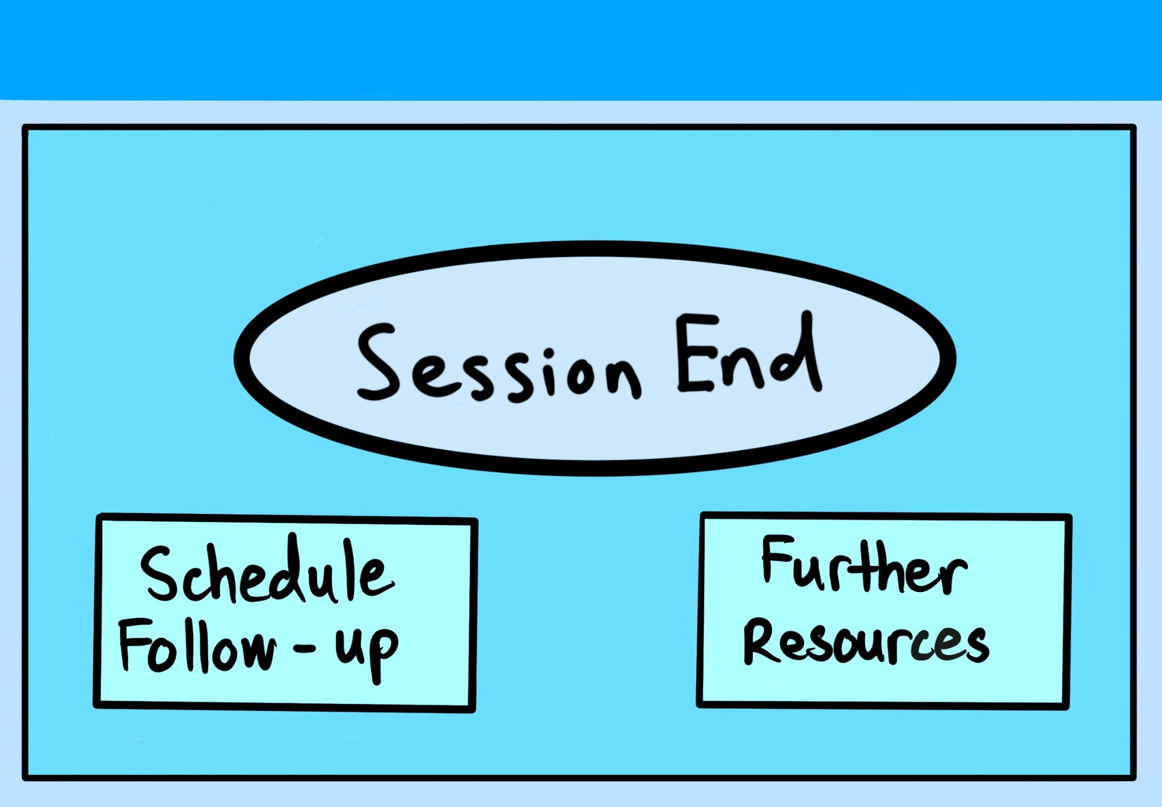
1. User selects online therapy from home page
2. User briefly describes their issue, and has the option of a chat or a call
3. The site matches the user to a provider and is connected
4. User is prompted to schedule follow up online sessions or further resources

Slide 10
Task 3: Using the Site to Find Nearby Affordable Medication
Why?
Helps users locate affordable medication options, reducing financial barriers to treatment.
Provides transparency by comparing medication prices and identifying discounts or assistance programs.
Supports long term treatment plans by making medication always available
Details:
Allows users to select from previously prescribed prescriptions or upload newly prescribed medication
Provides detailed pharmacy listings with location, contact information,, and user reviews.
Displays pricing for all availabilities (taking into account insurance) and allows user to compare

Slide 11
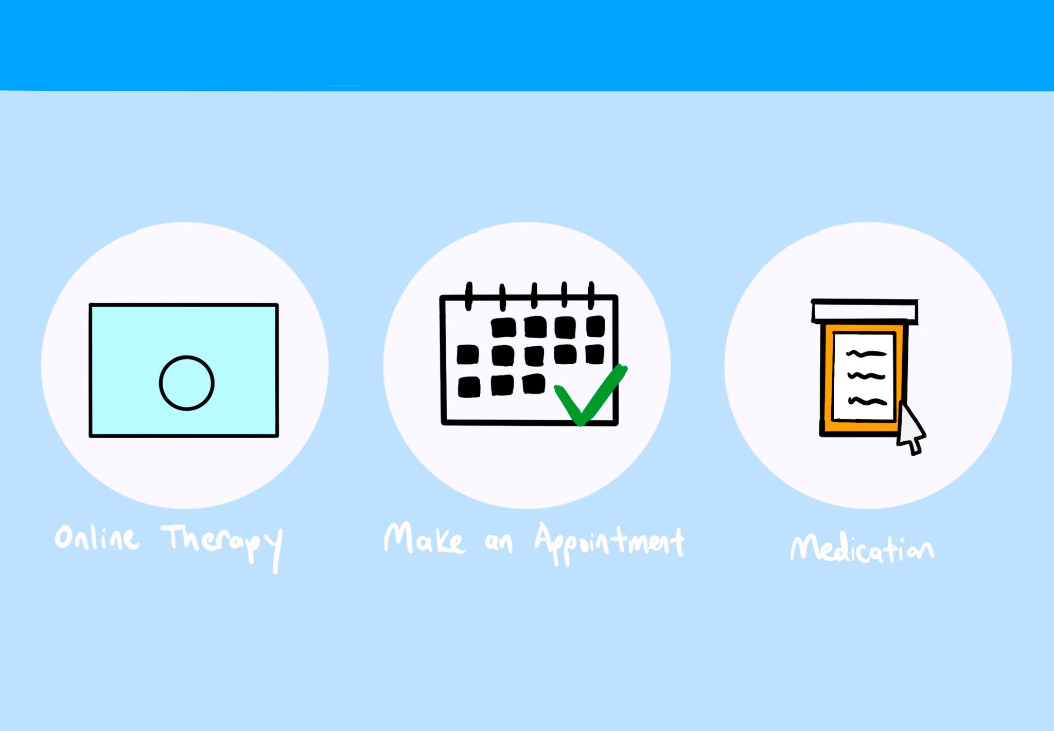
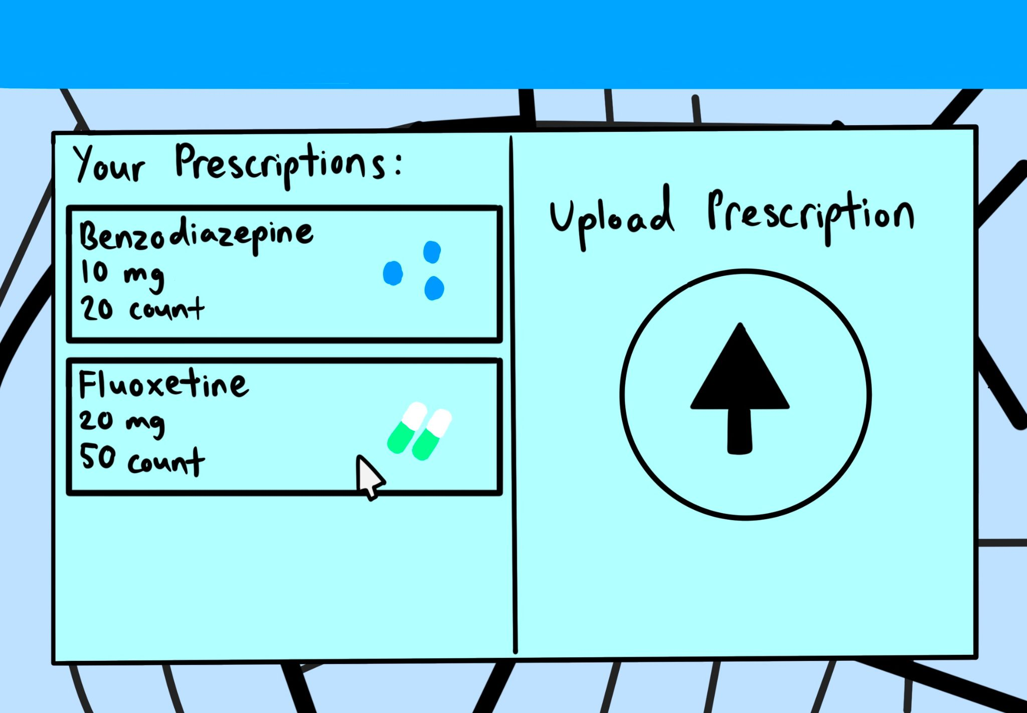
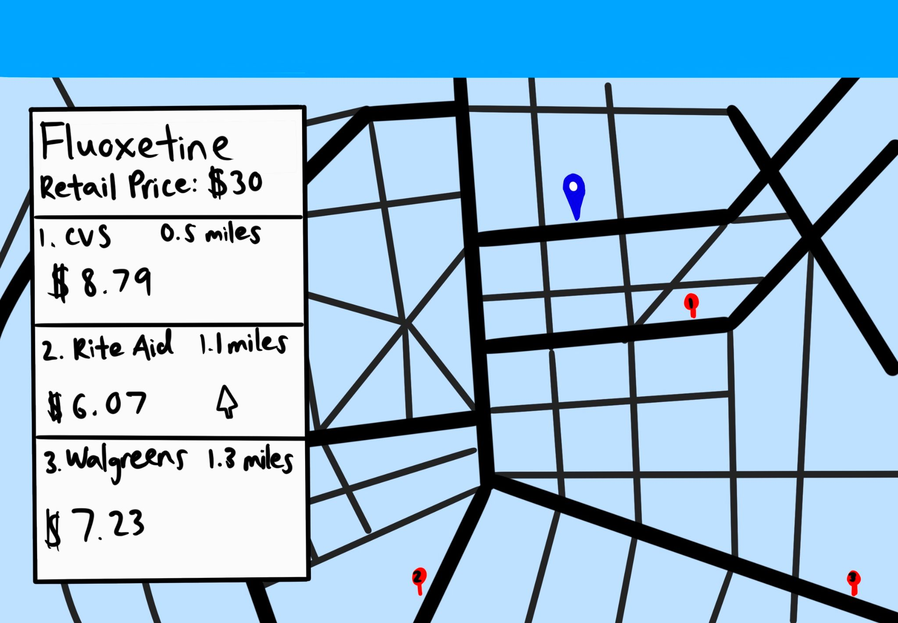
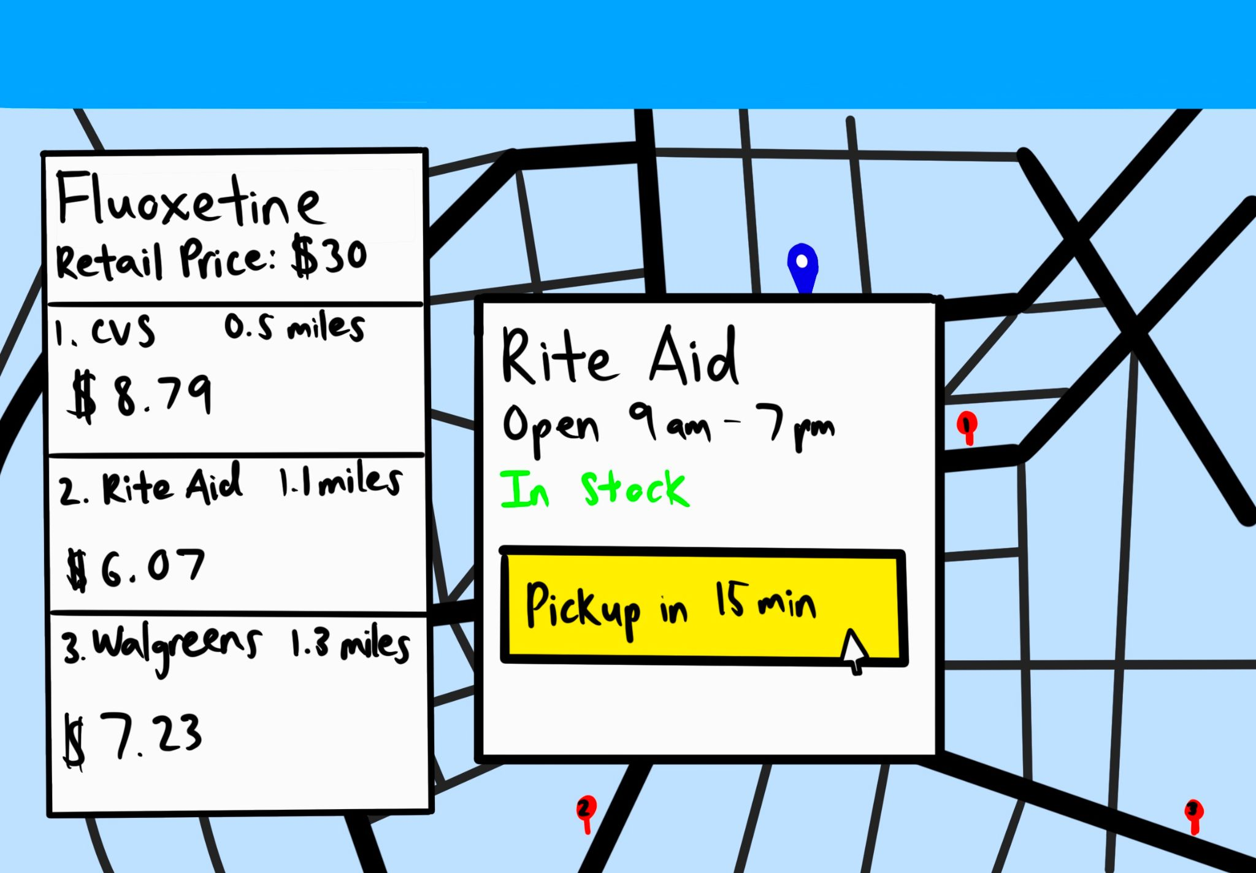
1. User chooses medication from the home page
2. User selects from saved prescription data or uploads new prescription
3. User sees locations with availability and pricing options
4. User schedules medication pickup

Slide 12
Questions?
Thank You For Your Time!

